Slide 1
Project Overview & Team
LiveDoc: Real-Time Intelligent Document Digitizer
LiveDoc goes beyond traditional scanning by utilizing deep document understanding to extract text, tables, and metadata, converting physical files into fully functional, editable digital assets in real-time.
Project Team
Viraj Patel (202611047)
Neel Prajapati (202611022)
Rushabh Shah (202611054)

Slide 2

Introduction & Core Problem
Traditional Scanning vs. LiveDoc
Traditional Scanning
The LiveDoc Vision
Creates static images or flat PDF documents; limited to
visual capture without semantic intelligence.
Moves beyond simple digitization to genuine document
understanding, capturing structural components like
headings, tables, diagrams, and metadata.

Slide 3
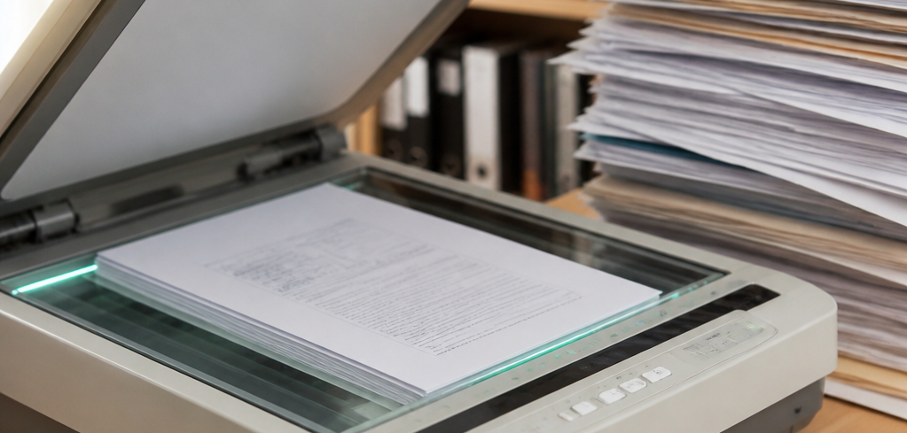
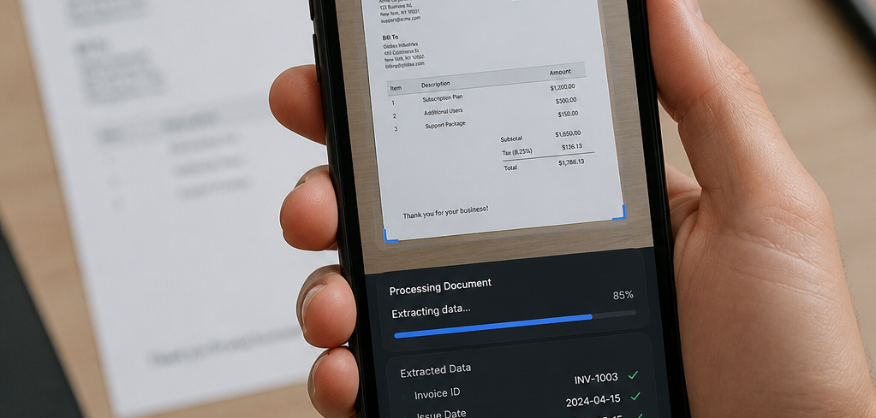
Existing Systems vs. LiveDoc
Comparing traditional document workflows with intelligent digital transformation
Conventional Approach
LiveDoc Proposed Approach
Physical Document → Image → OCR Text. Primarily focuses on
preserving the visual representation of the document.
Physical Document → Live Camera → Intelligent Processing →
Structured Digital Document. Seamlessly integrates capture,
extraction, and validation for immediate data utility.

Slide 4


Real-Time Camera Processing
Transitioning from static imaging to automated, live-feed capture for higher precision.
Real-Time Checks
Best Frame Selection
Instant document detection, alignment
analysis, and quality monitoring for blur or
glare.
Continuous frame evaluation and intelligent
filtering to ensure the highest-fidelity capture.

Slide 5






The System Pipeline: Capture Phase
Key stages of the document acquisition process
Document
Detection
Position &
Boundary
Detection
Quality /
Stability Check
Best Frame
Selection
Perspective
Correction
Live Camera Feed
Streaming input
capture from
the device
sensor.
Identifying the
document's
presence and
extent within
the frame.
Mapping corner
points and
document
geometry.
Analyzing focus,
lighting, and
motion blur.
Choosing the
optimal frame
from the stream
for clarity.
Rectifying
framing angles
to create a top-
down view.

Slide 6




The System Pipeline: Understanding Phase
Key stages for document processing and data extraction
Image Preprocessing
Document
Understanding
Validation &
Verification
Structured Digital
Output
Optimizing document
quality, noise reduction,
and binarization for feature
extraction.
Segmenting and classifying
document components
including text, tables, and
diagrams.
Ensuring accuracy through
business logic, cross-
referencing, and
confidence scoring.
Converting validated data
into machine-
understandable formats for
downstream integration.

Slide 7


Validation and Verification Principle
Moving beyond basic OCR for high-fidelity data capture
Beyond OCR
The Extraction Lifecycle
Distinguishing between technical OCR errors
and genuine data inconsistencies.
A systematic workflow: Extract, Validate, Flag,
Preserve, and Authorized Correction.
Ensures the absolute integrity and auditability of original documentation.

Slide 8
Validation Techniques
Multi-layered verification processes to ensure data accuracy
OCR Confidence Tracking
Format Validation
Data-Type Validation
Monitors character recognition
scores to flag potential extraction
errors.
Enforces strict structures for critical
data like dates, IDs, and email
addresses.
Ensures inputs match expected
formats, distinguishing between
numeric and text strings.
Cross-Field Validation
Table Consistency Analysis
Performs logical consistency checks, such as mathematical
verification of totals.
Validates the structural integrity of extracted grid and
tabular data.

Slide 9
Separation of Responsibilities
A modular approach to document processing architecture
Camera
Computer
Vision
Document
Processing
Document
AI / OCR
Validation
Output
Captures raw
visual input of
the document.
Performs object
detection and
geometric
alignment.
Applies image
enhancement
and noise
reduction.
Executes layout
analysis and
text recognition.
Applies
business logic
and data
integrity checks.
Generates the
final structured
data format.

Slide 10
Basic Technology Stack
Core infrastructure optimized for computer vision and data extraction
Python
  Primary development language for backend logic and
  workflow orchestration.
OpenCV
  Advanced library utilized for camera interaction and
  geometric image processing.
NumPy
  Essential framework enabling high-performance
  numerical operations and data analysis.
Document AI & OCR
  Specialized engines designed for industry-standard text
  recognition and extraction.
PDF / JSON Libraries
  Reliable tools for generating structured document
  formats and standardized data outputs.

Slide 11
Structured Output Representation
Ensuring semantic integrity for downstream automation
Metadata & Title
  Contextual identifiers used for document tracking and
  indexing.
Extracted Text Blocks
  Segmented content preserved with semantic relevance.
Tabular Data
  Organized datasets formatted for analytical processing.
Independent Images/Diagrams
  Decoupled visual assets prepared for modular
  integration.
Universal Support
  Seamless conversion into JSON for workflows and
  DOCX for professional delivery.

Slide 12

Domain Application: Government Records
Transforming Public Sector Documentation through LiveDoc
Official Documentation
  Streamlining the processing of
  vital records like birth, marriage,
  and death certificates.
Administrative Forms
  Automated intake and
  digitization for complex
  government application
  workflows.
Archive Management
  Converting historical paper
  records into structured,
  searchable digital databases.
High Accuracy
  Precision-engineered
  specifically for the rigorous
  demands of official government
  archives.
Data Integrity
  Built-in validation layers
  ensuring consistency and
  reliability for sensitive public
  data.
Searchable Accessibility
  Indexing content for rapid
  retrieval while preserving
  original document values.

